Slide 1


GIRIJANANDA CHOWDHURY INSTITUTE OF MANAGEMENT AND TECHNOLOGY, AZARA
DEPARTMENT OF COMPUTER SCIENCE AND ENGINEERING
TOPIC: TWITTER SENTIMENT ANALYSIS USING MACHINE LEARNING
GROUP MEMBERS:
MANAS PRATIM DUTTA - 190310007028
NITU ALAM - 190310007031
PROJECT GUIDE:
RITUSHREE DUTTA
ASSISTANT PROFESSOR,CSE,
GIMT

Slide 2
INTRODUCTION
Sentiment analysis is a popular task in Natural Language processing (NLP).
Sentiment Analysis is a process of extracting information from large amounts of data, and classifying them into different classes called sentiments.
Sentimental analysis is often called opinion mining.
The goal of sentiment analysis is to classify the text based on the mood or mentality expressed in the text, which can be positive or negative.
Sentiment Analysis can be done at document, phrase and sentence level.

Slide 3
WHY TWITTER?
Large Volume of Data
Concise and Informal Language
Hashtags and Trends
Opinion Mining
Customer Feedback and Brand Monitoring
Sentiment-based Market Research

Slide 4

AIM
The main aim is to analyse the tweets from twitter application api dataset and then try to build machine learning models that can classify whether the tweets are positive or negative.

Slide 5

OBJECTIVE
To implement various machine learning algorithms for automatic classification of text data into positive or negative.

Slide 6
LITERATURE SURVEY
SL.NO. | TITLE | AUTHORS | TECHNIQUES | ACCURACY
1 | Study of Twitter Sentiment Analysis using Machine Learning Algorithms on Python | Bhumika Gupta and Monika Negi, Kanika Vishwakarma, Goldi Rawal | SVM, Naives' Bayes, Random Forest Classification,DAN2 | 85%,66.24%,87., 86.06%
2 | Sentiment analysis of Twitter Data: A Survey of techniques. | Vishal A. Kharde,S.S. Sonawane | SVM, Naives' Bayes | 76.68%,74.56%
3 | Sentiment Analysis of Twitter text using machine learning algorithms | Hawar Sameen Ali Barzenji | Gaussian Naïve Bayes Classifier, SVM classifier, Random Forest Classifier | 72%,89%,88%
4 | Sentiment Analysis using NLP and Machine Learning Techniques on Social Media Data. | M.Kavitha,R.Srinivasan | Random Forest Tree,Decision Tree,Logistic Regression | 95%,83%,78%

Slide 7
LITERATURE SURVEY
SL.NO. | TITLE | AUTHORS | TECHNIQUES | ACCURACY
5 | Sentimental Analysis of Twitter Data using Machine Learning Approaches | Bandaru Mounika and Dr. M.S.V.S Bhadri Raju | Naive Bayes,SVM,Random Forest,Decision Tree | 85%,95.5%,95.3,89%
6 | Sentimental Analysis using Twitter Data based on Machine Learning | Yuxingqi and Zahratu,Shabrina | SVC,Logistic Regression,Random Forest | 71%,75%,82%
7 | Sentimental Analysis on Twitter Data using Machine Learning Algorithms in Python | S.Siddharth and R.Darsini | Naive Bayes, Random Forest | 89.9%,87.2
8 | Sentiment Analysis Using Machine Learning Algorithms | Fatma Jemai,Mohamed Hayouni | Naive Bayes,Logistic Regression ,LinearSVC classifier | 79%,78%,75%

Slide 8
METHODOLOGY
Input Dataset
(Twitter)
Text Preprocessing
(Tokenization, stop words removal, etc)
Exploratory Data Analysis
(EDA)
Cross Validation
(Train Test Split)
Feature Extraction
(Countvectorizer, TF-IDF)
Machine Learning Algorithms
(SVC, KNN, etc)
Output
(Positive/Negative)

Slide 9
STEPS INVOLVED IN PROPOSED METHODOLOGY
DATASET USED
The dataset used contains 31,962 tweets extracted using the twitter api.
The tweets have been annotated (0 = positive i.e, the tweets that is not racist/sexist and 1= negative that is racist/sexist) and they can be used to detect sentiment of the users

Slide 10
IMPORTED MODULES/LIBRARIES
Data Manipulation Libraries: (Numpy, Pandas, RE, String)
Data Visualization Libraries: (Matplotlib, Seaborn)
Data Preprocessing Libraries: (NLTK, PorterStemmer)
Feature Extraction Libraries : (Countvectorizer. BOW, TF-IDF)

Slide 11
TEXT PREPROCESSING TECHNIQUES
1. CASING :
(Converting the uppercase characters into lowercase characters and vice-versa)
2. NOISE REMOVAL :
(Removal of special characters, numbers and punctuations, hashtag, white space ,etc)
3. TOKENIZATION :
(Splitting the sentences into small meaningful words to understand the importance of each word with respect to the sentence)

Slide 12
TEXT PREPROCESSING TECHNIQUES
4. STOPWORDS REMOVAL :
(To remove the commonly used words which doesn’t add value to the task we are carrying out)
5. TEXT NORMALIZATION :
STEMMING:
(Normalize words into its base form by cutting the beginning and ending of the words)
LEMMATIZATION:
(Normalize words by linking words into similar meaning words)

Slide 13
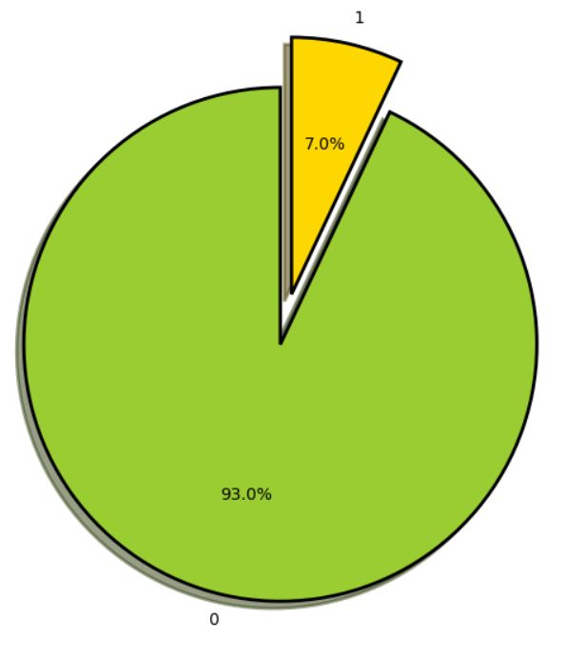
EXPLORATORY DATA ANALYSIS
Visual Representation of distribution of positive and negative sentiments using Pie Chart

Slide 14
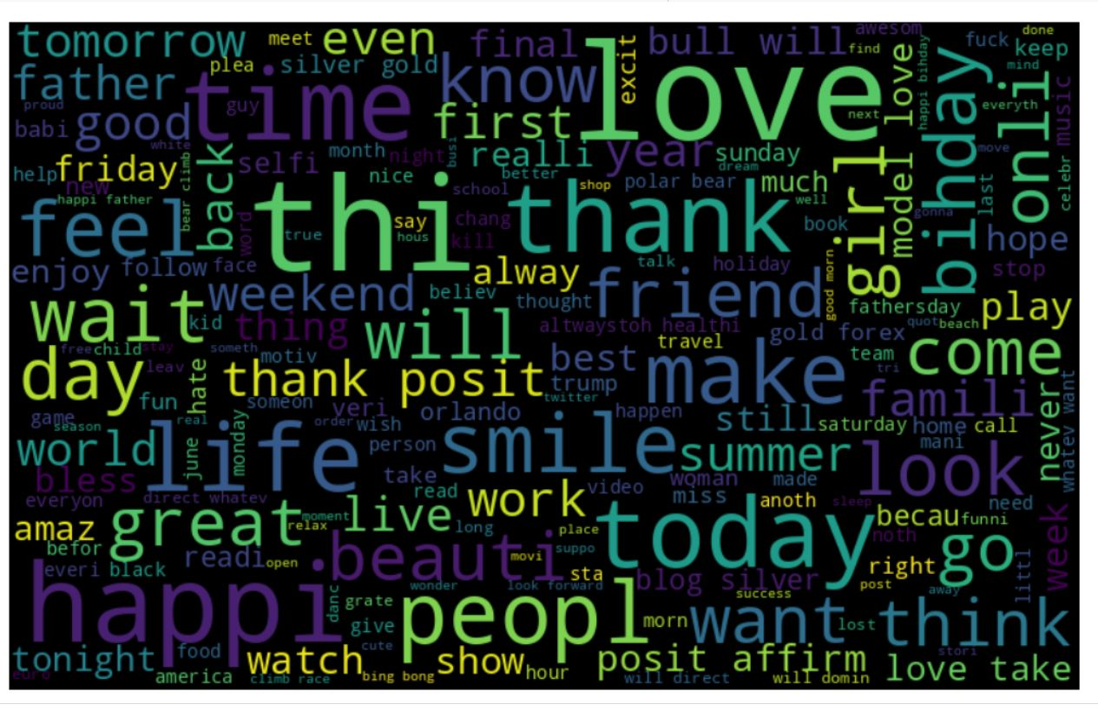
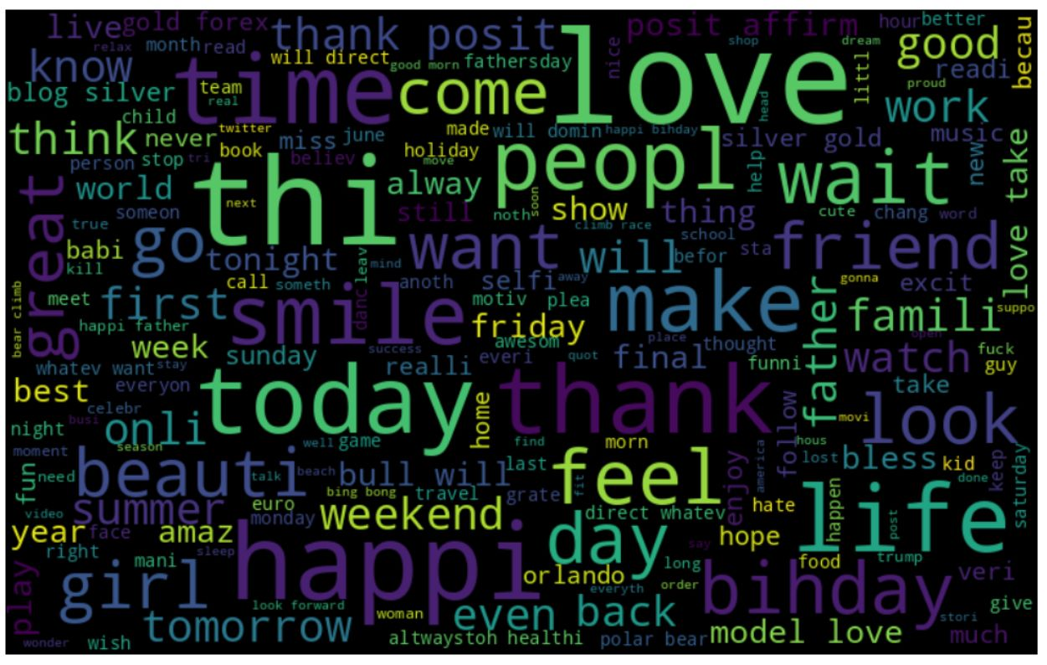
EXPLORATORY DATA ANALYSIS
Word Cloud Visualization of frequent words
Word Cloud Visualization Of The Frequent Words Word Cloud Visualization Of The Positive Words

Slide 15
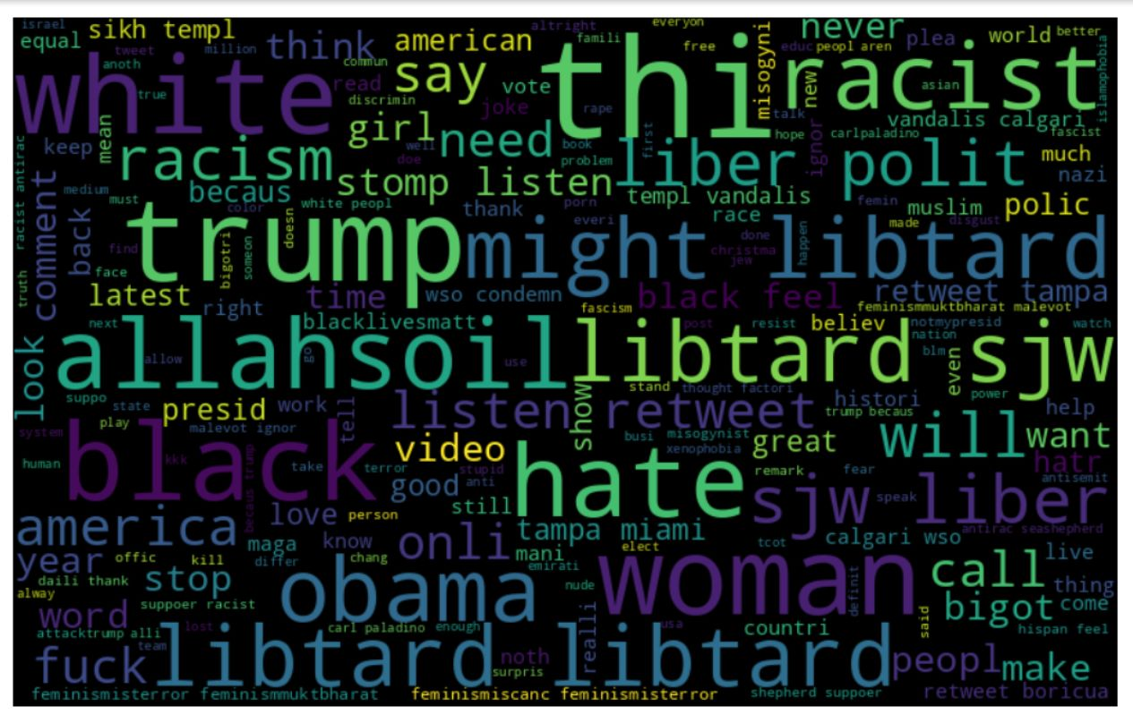
EXPLORATORY DATA ANALYSIS
Word Cloud Visualization Of The Negative Words

Slide 16
FEATURE EXTRACTION
COUNTVECTORIZER
(It is used to transform a given text into a vector on the basis of frequency (count) of each word that occurs in the entire text)
TFIDFVECTORIZER
(TF-IDF stands for Term Frequency - Inverse Document Frequency. It is defined as the calculation of how relevant a word in a series or corpus is to a text)

Slide 17
CLASSIFICATION MODELS USED
LOGISTIC REGRESSION
SUPPORT VECTOR CLASSIFIER
NAIVE BAYES CLASSIFIER
RANDOM FOREST CLASSIFIER
K-NEAREST NEIGHBORS CLASSIFIER

Slide 18
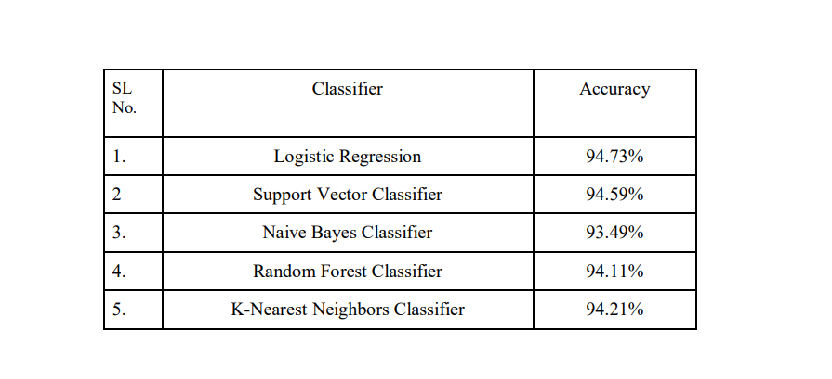
RESULTS
Average Accuracies Of Different Models

Slide 19
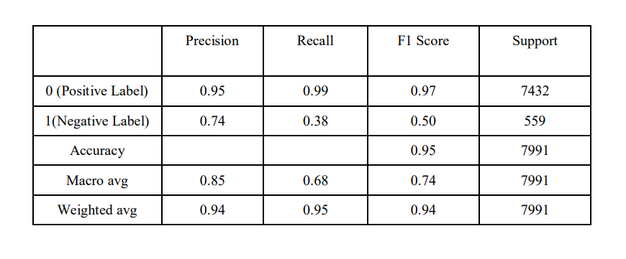
Classification Report Of Logistic Regression

Slide 20
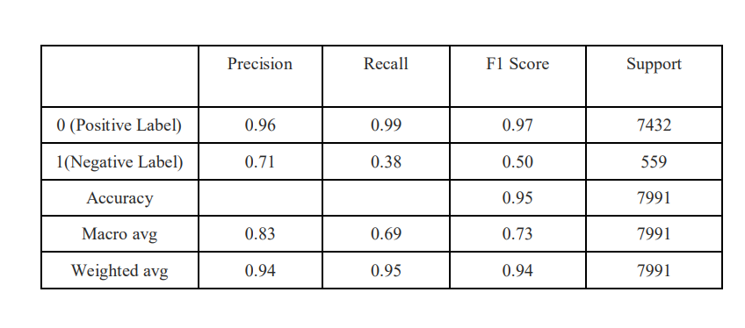
Classification Report Of Support Vector Classifier

Slide 21
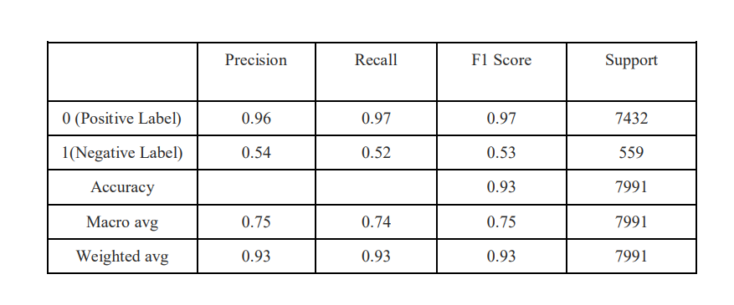
Classification Report Of Naive Bayes Classifier

Slide 22
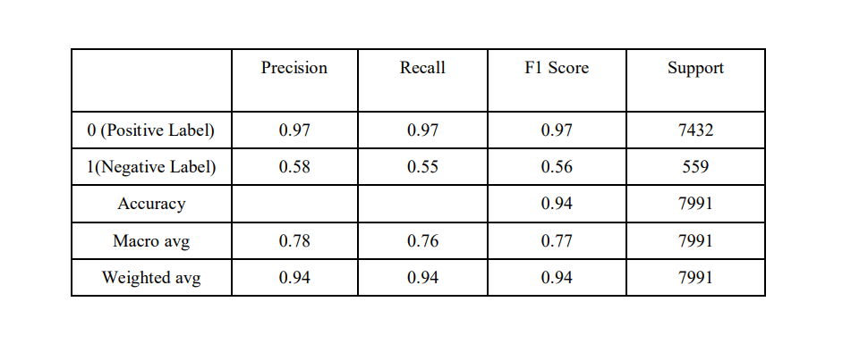
Classification Report Of Random Forest Classifier

Slide 23
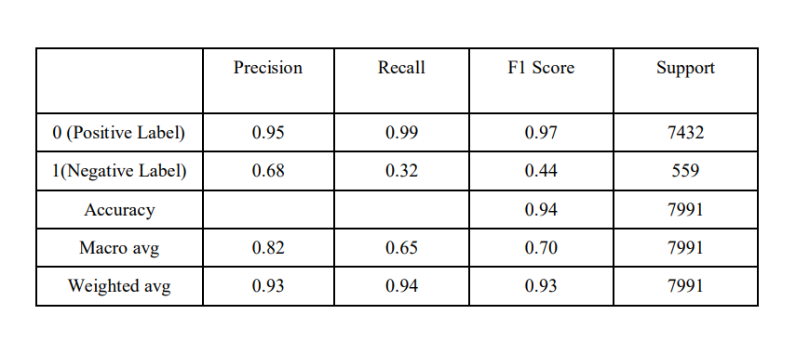
Classification Report Of K-Nearest Neighbors

Slide 24
CONCLUSION
In this project we tried to show the basic way of classifying tweets into positive or negative categories using various classification algorithms.
We have done processing and analysis on the tweets to get insights, patterns or information from it , and use various visualization techniques to visualize or get better idea about it.
We could further improve our classifier by trying to extract more features from the tweets, trying various preprocessing techniques, tuning the hyperparameters and model parameters, and using various other data visualization techniques to get better insights about the tweets.

Slide 25
REFERENCES
[1] Anuja P Jain and Padma Dandannavar “Applications of Machine Techniques to Sentiment Analysis”, In 2nd International Conference on Applied and Theoretical Computing and Communication Technology (iCATccT) 978-1-5090-2399-8/16 IEEE-2016.
[2] Bholane Savita Dattu, and Deepali V. Gore "A Survey on Sentiment Analysis on Twitter Data Using Different Techniques'', In (IJCSIT) International Journal of Computer Science and Information Technologies, Vol.6(6), 2015, 5358-53562.
[3] Mr. Saifee Vohra and Jay Teraiya “Applications and Challenges for Sentiment Analysis: A Survey”, In (IJERT) international Journal of Engineering Research & Technology ISSN: 2278- 0181, Vol. 2 Issue 2, February 2013.
[4] Geetika Gautam, Divakar yadav " Sentiment Analysis of Twitter Data Using Machine Learning Approaches and Semantic Analysis ", In IEEE Contemporary Computing (IC3), 2014 Seventh International Conference on 7-9 Aug. 2014.

Slide 26

Thank You

